Slide 1
Extracting Data points

Slide 2
Some results
"content":{ "D.":" Right thumb, amputation:\n?\tUlcerated keratinizing squamous cell carcinoma, moderately differentiated, extending 6 mm into the dermis and subcutaneous tissue, and completely excised. \n?\tUnderlying viable bone with fatty marrow, but no evidence of carcinoma.", "B.":" Margin #1 of right thumb, excision:\n?\tAcral skin and dermis with no specific pathological change. \n\n", "C.":" Margin #3 of right thumb, excision:\n?\tSkin and underlying dermis with no specific pathological change.\n\n", "A.":" Margin #2 of thumb, excision:\n?\tAcral skin and underlying dermis with no specific pathological change.\n\n" }, "Skin Cancer":{ "Total Lymph Nodes_Number of Positive":"_", "Total Lymph Nodes_Size of Longest Metastasis":"_ mm", "Histologic Type of Tumor":"Keratinizing squamous cell", "Perineural Invasion":"Not identified", "Lymphovascular Invasion":"Not identified", "Anatomic Site of Tumor":"Right thumb", "Depth of Invasion":"Subcutaneous tissue to the level of bone", "Total Lymph Nodes":"0", "Underlying Bone Invasion":"Not identified", "Total Lymph Nodes_Extranodal Extension":"_", "Margins":"Clear", "Histologic Type of Tumor_Grade":"2 of 3", "Histologic Type of Tumor_Size":"5.8 x 5.2 cm", "Total Lymph Nodes_Other Metastatic Sites":"_ N/A" } },
Skin Cancer Staging Summary
Anatomic Site of Tumor: left auricle of ear
Depth of Invasion: deep dermis to level of cartilage
Histologic Type of Tumor keratinizing squamous cell carcinoma
Size: 3.2 x 3 cm
Grade: 1-2 of 3
Lymphovascular Invasion: not identified
Perineural Invasion: not identified
Underlying Bone Invasion:
Margins: final margins clear
Total Lymph Nodes: zero
Number of Positive: _
Size of Longest Metastasis: _ mm
Extranodal Extension: _
Other Metastatic Sites _ N/A

Slide 3
Overview
Objective: Extracting data points and corresponding values contained in the note
Input: Structured pathology note
Algorithm: Regular Expression, Rule-based
Output: Cancer types, data points and values

Slide 4
Algorithm
Search for keyword “Staging summary”
Divide text contained in each note into group(s) based on “Staging summary”
Boundary of each group: from current “Staging summary” to previous line before the next one that contain “Staging summary”
Capture cancer type by collecting previous text before “Staging summary” in that line
If length of previous text is greater than some threshold, ignore this part (Do not make this “Staging summary” as a keyword)

Slide 5

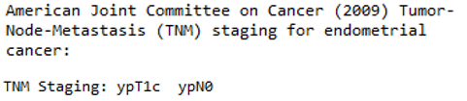
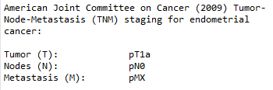
Algorithm
For each group of text, we process line by line
Cut-off the end of text with keyword “tnm(tmn) staging”
If “tnm staging:” is found, cut-off at the end of that line (case 1)
Else, process the next line that is not empty
If “tnm staging:” is found, cut-off at the end of that line (case 2)
Else, process the following lines until the empty line is found (case 3)

Slide 6
Algorithm
Each group of text contains several blocks of information
Block is defined as data point and value (may contain sub-data point)
Divide text into blocks and Process block by block
Step 1: First check whether there is sub-data point by checking for “\t”
Step 2: No sub-data point: simply process by taking data point and its value in one line
With sub-data point: recursively repeat step1 and 2

Slide 7
Result
A multiple layers of dictionaries
Key: note no e.g. 0,1,…,n
Value: a dictionary with a size of (total number of cancer type)+1
Key: Cancer type
ValueType1: a dictionary of data points and their value
Key: data point
Value: a list of value corresponding to its data point and the original text
ValueType2:
Key: “content”
Value: the remaining content in the note that have not been processed

Slide 8
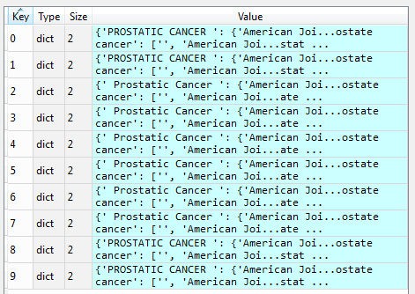
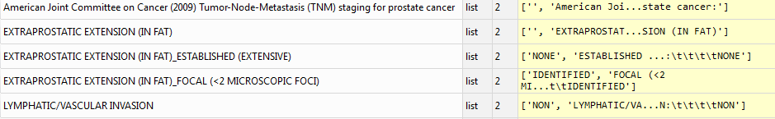

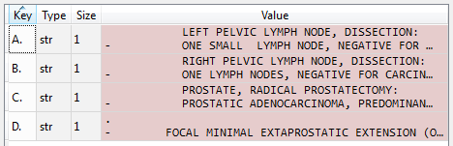

Result

Slide 9
Confidence score
This confidence score is to test our extracted result, not for the actual data. E.g. it wont tell you how accurate the actual data is.
Confidence score analysis is important because the data is not clean. Some errors are unavoidable, and we have to check.

